Slide 1

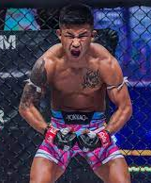
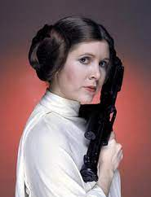
Mike
Trey
Mariel
Who are the Booooleans…

Slide 2
Brief comments about
Webscraping

Slide 3
Exploratory Analysis, A and B…
Question A
How often does the candidate who raised more money win a race?
.8902 = (381/428)
89%
Question B
How often does the candidate who spent more money win a race?
.8831 = (378/428)
88%

Slide 4
Exploratory Analysis, C…
Question C: Does the difference between either money raised or money spent seem to influence the likelihood of a candidate winning a race?? Tested via p values…
Spent = p value of 0.0
Raised = p value of 0.0
Correlation is not high!
Win and Spent= .206
Win and Raised = .233

Slide 5
Exploratory Analysis, D…
Question D
How often does the incumbent candidate win a race?
.8925 = (382/428)
.89%

Slide 6
Exploratory Analysis, E…
Question E: Can you detect any relationship between amount of money raised and the incumbent status of a candidate?
Percentage Raised, Percentage Spent, both give a p-value of 0.0! ~ They are significant!
Note that:
They are not independent!
They are probably non normal…

Slide 7
Exploratory Analysis, E…Are they independent?
Question E: Can you detect any relationship between amount of money raised and the incumbent status of a candidate?
Note that they are not independent!
Test for multicollinearity
Feature VIF
Per_Raised 334.709227
Per_Spent 343.377167
Vote_Perc 7.958437

Slide 8
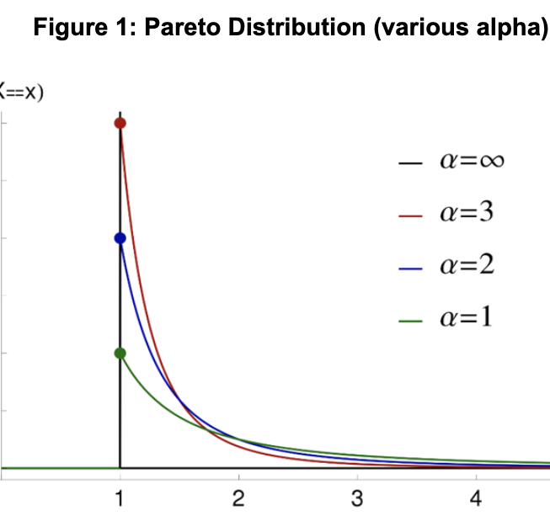
The Pareto Dist
Major implications in our society.
Original use case, describing the distribution of wealth across individuals in a society.
This and it’s associated, prices law, describe many naturally occurring distributions.

Slide 9
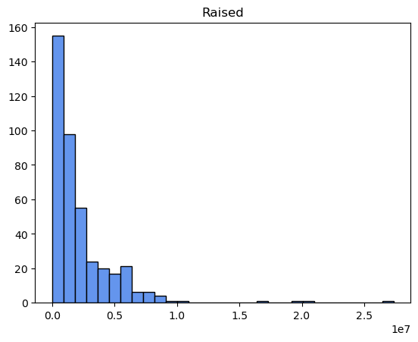
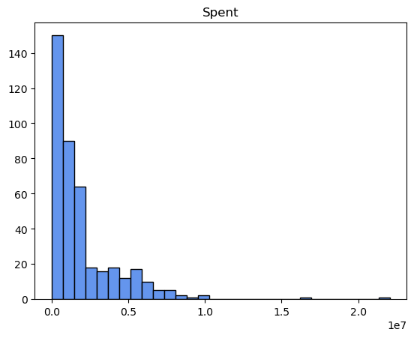
Histograms, Raised and Spent, Democrats

Slide 10
Tests for Normality…
Wilks-Shapiro
ShapiroResult:
(statistic=0.56403386 pvalue=1.0054e-44)
Kolmogorov-Smirnov
KstestResult:
(statistic=0.993811, pvalue=0.0)

Slide 11
Part 3 Logistic Regression…
Base Model
Winner Response variable
Explanatory = % Spent
coeff P>|z|
% Spent 0.0877 0.000
#The odds of winning multiply by exp(.0877) = 1.9160 for a unit increase in 'Per_Spent'
#The intercept coefficient of 4.4026 denotes the baseline log odds
#exp(.0877) = 1.9160 are the odds when 'Per_Spent' = 0.

Slide 12
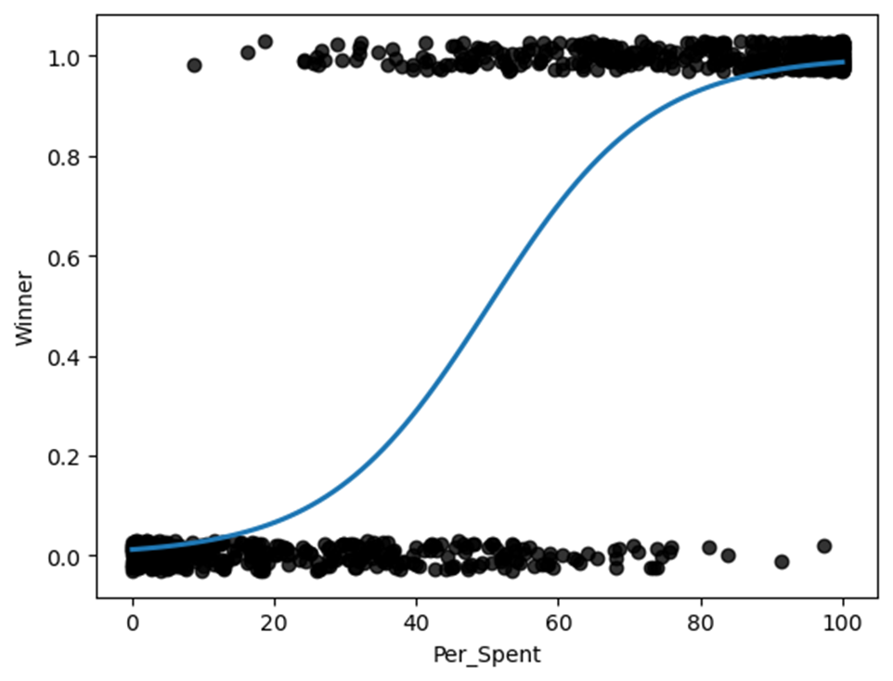
Part 3 Logistic Regression…
2 Variable graphic W ‘jitter’

Slide 13
Part 3 Logistic Regression, 3 Variables…
3 Variable Model
Keep Winner… Add Incumbent
Explanatory = % Spent
coeff P>|z|
Per_Spent 0.0615 0.000
Incumbent 3.2510 0.000
The odds of winning multiply by exp(.0615) =1.063 for a unit increase in 'Per_Spent
The odds of winning multiply by exp(3.215) = 24.9 for a unit increase in ‘Incumbent’

Slide 14
Part 3 Logistic Regression…Check for Multicollinearity!
> 2.5 indicates high multicolinearity
Feature VIF
0 Per_Spent 4.465027
1 Incumbent 4.465027

Slide 15
Part 3 Logistic Regression…5 Variables…
Previous Model +
+ Incumbent
+Party (R, D, I…yields 2 more categorical variables…
0 1
Intercept 0.000374 0.004581
C(Party)[T.I] 0.000000 inf
C(Party)[T.R] 5.732240 33.578495
Per_Spent 1.063846 1.098480
Incumbent 20.273180 108.970659
These are the odds confidence intervals. For instance:
# Per_Spent is 1.063846, 1.098480. For a unit increase in
# Per_Spent multiples the odds of winning by at least 1.063845
# and as much as 1.098480

Slide 16
Part 3 Logistic Regression… odds confidence intervals.
Intercept 0.000374 0.004581
C(Party)[T.I] 0.000000 inf
C(Party)[T.R] 5.732240 33.578495
Per_Spent 1.063846 1.098480
Incumbent 20.273180 108.970659
These are the odds confidence intervals. For instance: Per_Spent is 1.063846, 1.098480. For a unit increase in # Per_Spent multiples the odds of winning by at least 1.063845 and as much as 1.098480

Slide 17
Part 3 Logistic Regression…Comparing models…
Reduced Model = 2 Variable
Full Model = 5 Variable
Used Chi2 statistic to compare Full against Reduced model
P value = 6.229848635948064e-35
Since p value is very small we reject the H0, namely that the reduced model is better.

Slide 18
Part 2, cont….
feature VIF
0 Raised 30.713386
1 Spent 31.213454
2 Vote_Percentage 1.505297
VIF = Variation Inflation Factor
Tests for multicollinearity
Occurs when 2+ independent variables have a high correlation with one another.
VIF > 5-10 indicates m.c.
Test indicates high multicollinearity!

Slide 19

Part 3
DONE!

Slide 20

This Means That…
Explanatory = % Spent Per District
Response = Winning Election
The odds of winning multiply by exp(-.0877) = 0.9160 for a unit increase in 'Per_Spent'
The intercept coefficient of 4.4026 denotes the baseline log odds
exp(-.0877) = 0.9160 are the odds when 'Per_Spent' = 0.
 | coef | std err | z | P>|z| | [0.025 | 0.975]
Intercept | 4.4026 | 0.322 | 13.679 | 0.000 | 3.772 | 5.033
Per_Spent | -0.0877 | 0.006 | -15.005 | 0.000 | -0.099 | -0.076

Slide 21
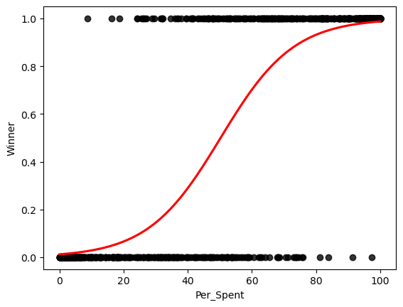
The Basic Plot
Explanatory = % Spent Per District
Response = Winning Election

Slide 22
Overview
Part One
Webscraping highlights
Part Two
a-e one or two slides
Dash!
Stats
Normality
Shapiro Wilks
VIF
Part Three
Base model
3 variate model
5 variate C(Party) model
Full vs. reduced
Deviance score
P value of models
Deliverable Notes
Dash!
Powerpoint
Prezi! (demo to team)
Other thoughts…
Whats VOC?
Whats the story?

